Slide 1
XML Configurations in Jiva

Slide 2
Purpose
The purpose of this presentation is to introduce audience to the list of different XML files in Jiva.
High level overview of each XML files and its configuration capabilities in Jiva.
Impacted screens/areas in Jiva w.r.t each config XML files.

Slide 3
List of XML files in Jiva

Slide 4
List of XML files that are used frequently…

Slide 5
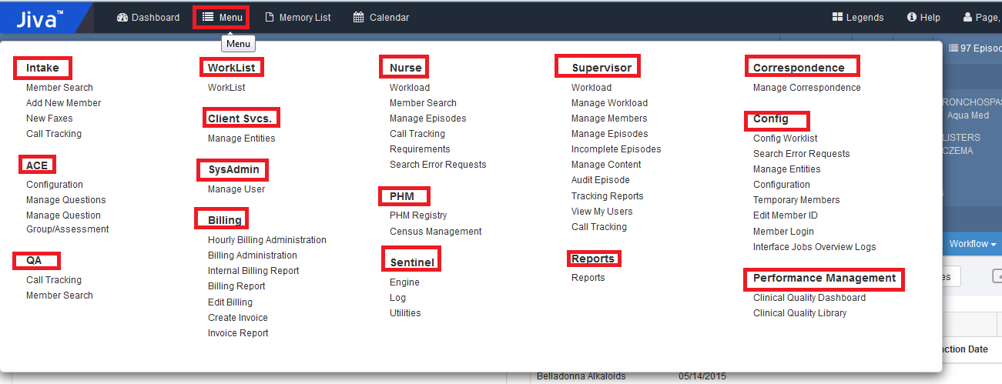
JivaNgTabs
This XML enables you to configure:
Main tabs of the Jiva– Intake, Nurse, Supervisor, Admin, Config etc…
Roles for which the tabs should be configured- CC, Supervisor etc.

Slide 6
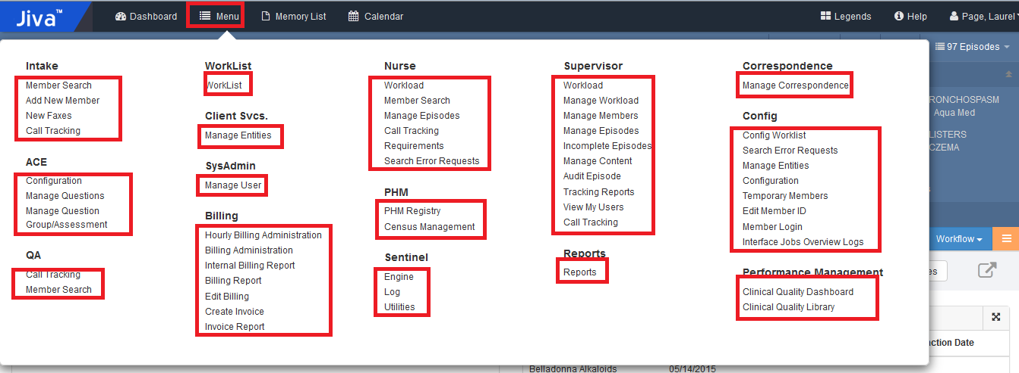
JivaNgInfoBar
This XML file enables you to configure the links under the Jiva tabs.
Sorting is taken care by default in Application.
For example: Member search, New Faxes , call tracking etc tabs under the Intake tab.

Slide 7
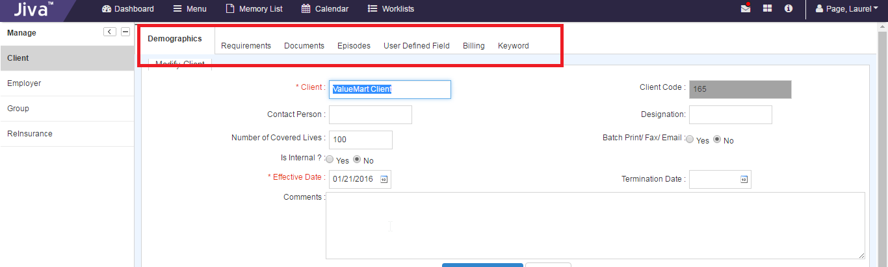
CEG_Menus
This XML file helps you to configure the tabs within the Client, Employer, and Group links that appear on the left navigation panel under the Client Svcs. Tab.
The path to view these links are:
ClientSvcs>Client>Search Client>Modify
Example : Demographics, Requirements, Documents, Billing etc.

Slide 8
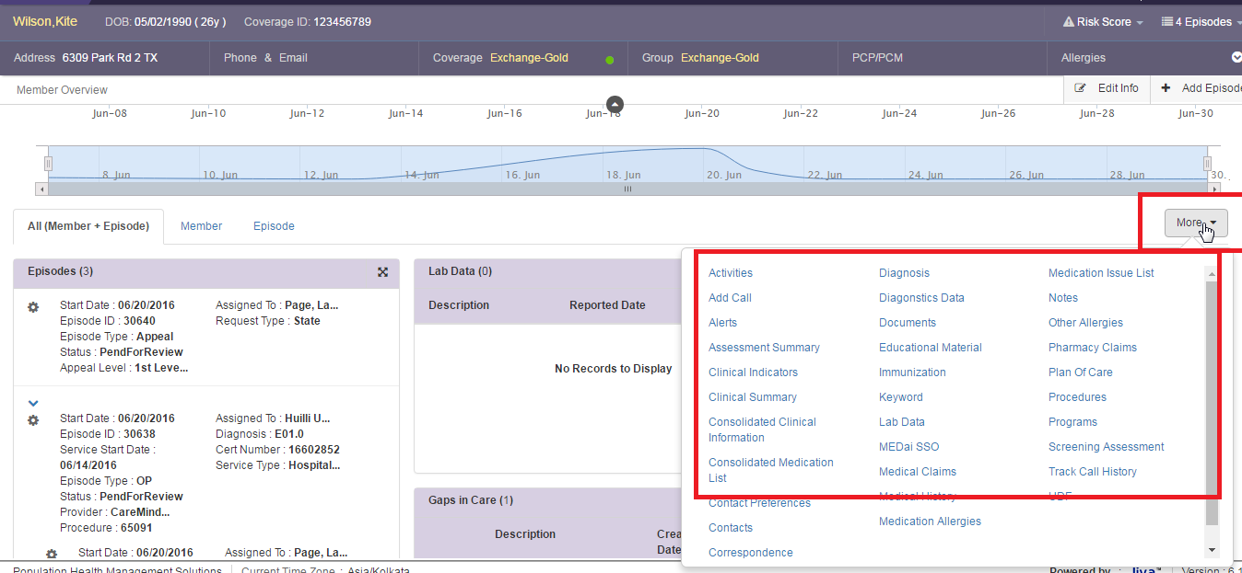
MemberCentricConf
This XML file enables you to configure the following:
More button at Member and Episode level
Sorting is taken care by default in UI
Roles can be configured for each link

Slide 9
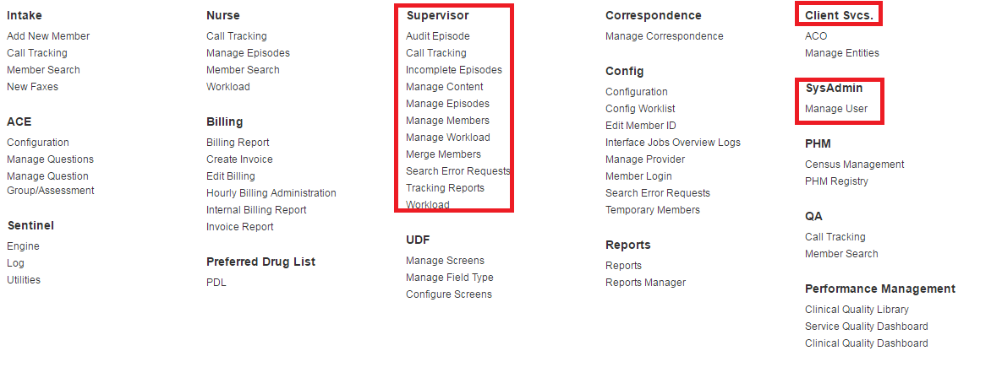
ManageEntities
This XML file enables you to configure the following:
Left navigation links for each tab.
For Example: Supervisor>Manage Content>Educational Material and News Letters
If we need to hide any link in this XML, we need to remove or comment the row

Slide 10
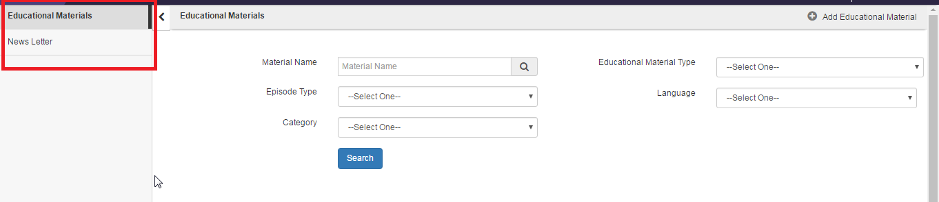
ManageEntities
This XML file enables you to configure the following:
Left navigation links for each tab.
For Example: Supervisor>Manage Content>Educational Material and News Letters

Slide 11
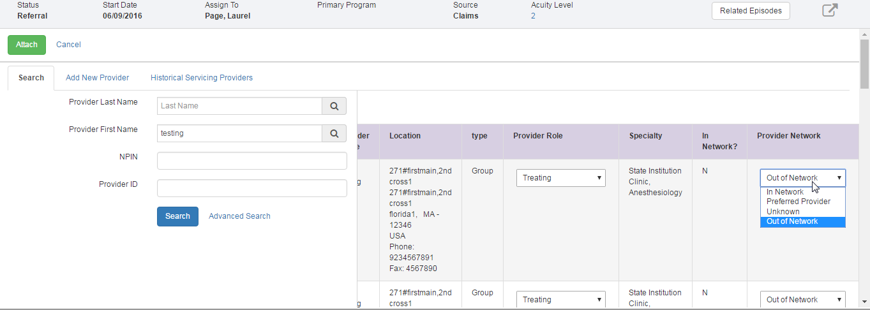
jivaConstant_values
This XML file enables you to configure network status of provider such as:
Hide of show network status
Different types of network status in the drop-down example: In Network, Out of Network

Slide 12
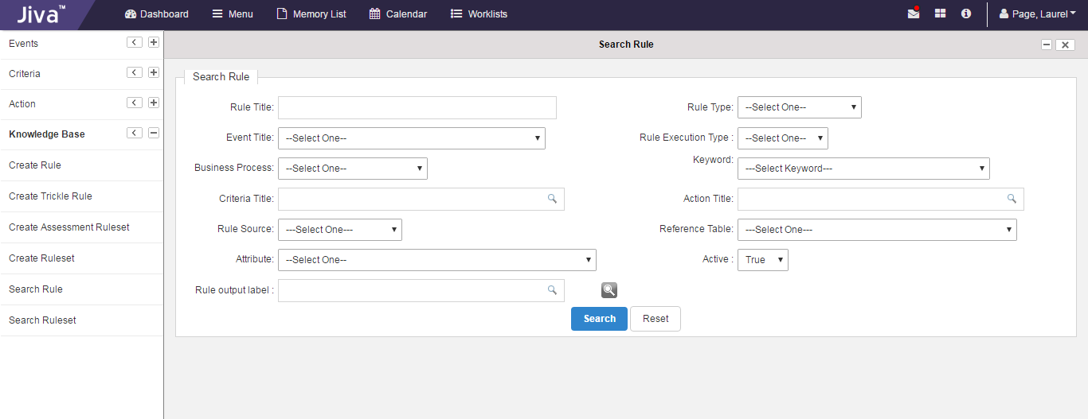
jivaLeftNavigation
This XML file enables you to configure the Left links Under ACE, Sentinel

Slide 13
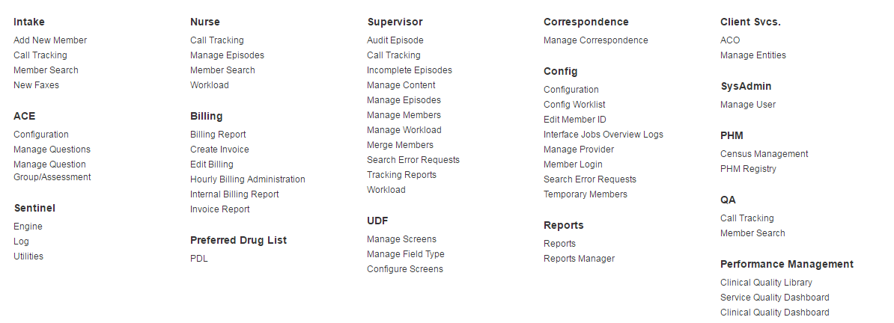
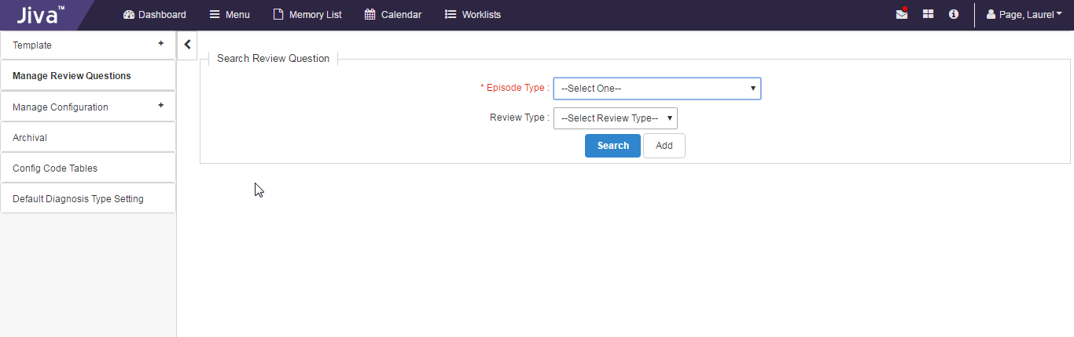
ManageAdminContent
This XML file enables you to configure all the left navigation links under the Config tab such as Template, Upload Image, Template Master etc

Slide 14
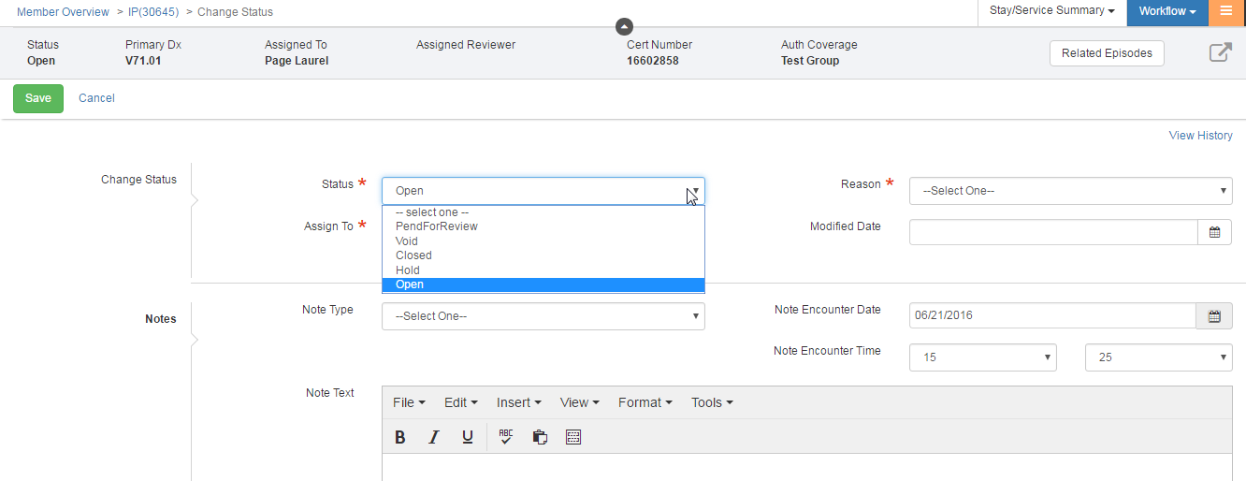
JivaWorkflow
This XML file enables you to configure the different episode status that you can change for each episode type.
The primary nodes are:
Initial State: Default status when a new episode is created
Destination: Different statues of the episode such as, Open, Closed, Pending etc.
Role: Roles for which the configured status will appear.

Slide 15
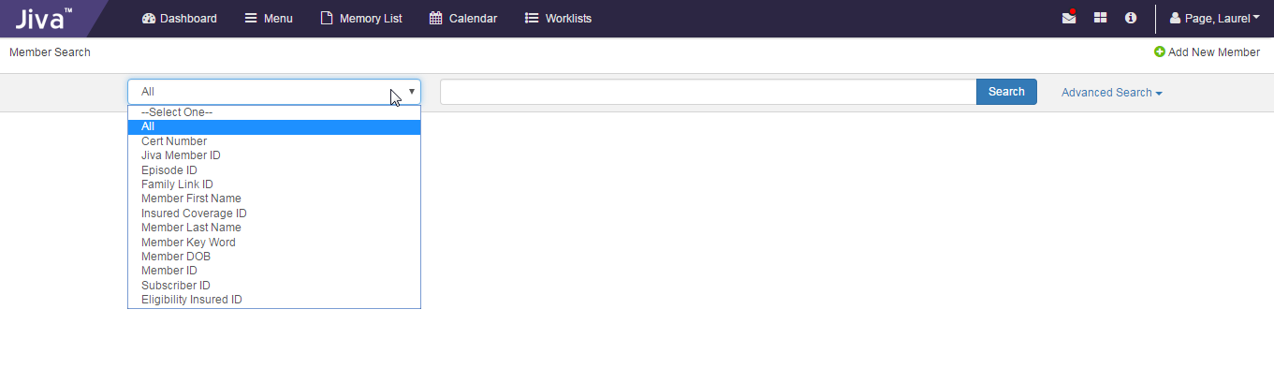
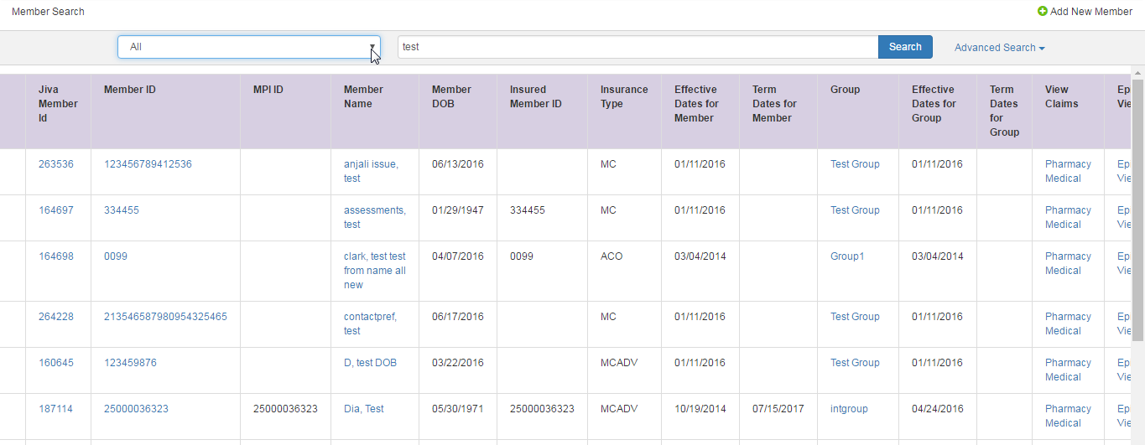
JivaMemberSearch
This XML file enables you to configure the member search and search result screen in nurse portal (Intake, New faxes, Member Merge), client portal, Provider portal.

Slide 16
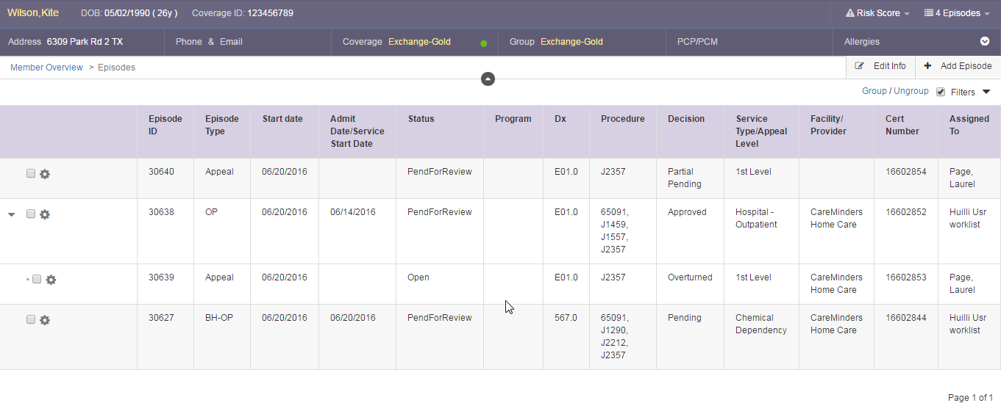
JivaEpisodeHeaderList
This XML file enables you to configure the Episode Column Heading in MCV episode view.
Header name can be configured, Order of columns can be changed by placing the column tabs in XML in required order.

Slide 17
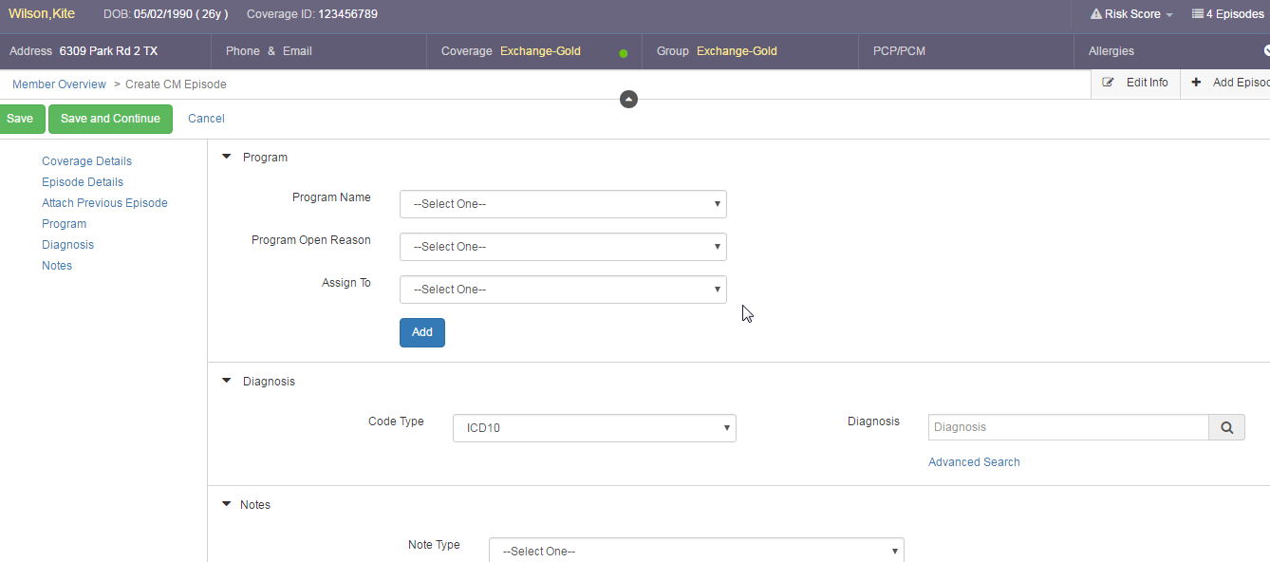
JivaEpisodeDiagMapping
This XML file enables you to configure the “Diagnosis” and “Program” field in add episode step 1 screen for different episode types in Jiva.

Slide 18
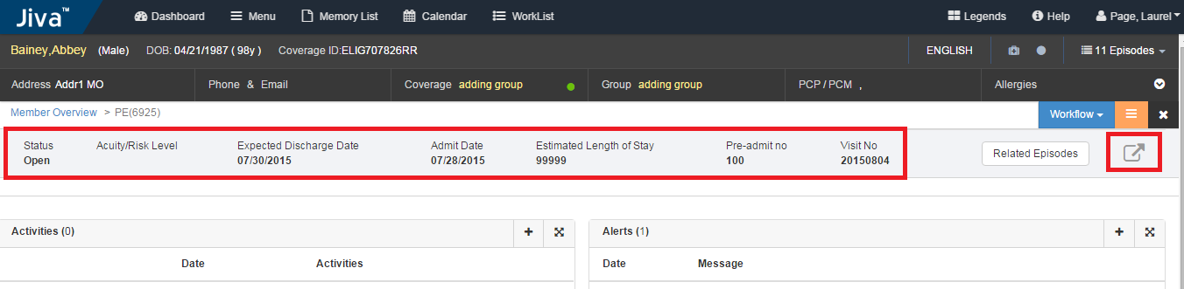
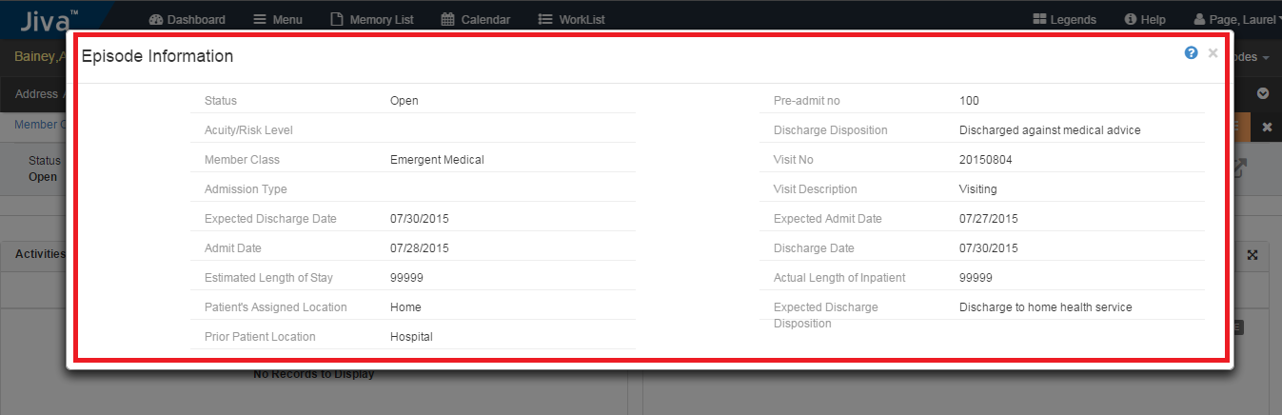
EpisodeBannerConf
This XML file enables you to configure the episode banner fields.
Can configure whether to show in banner or in popup, we can select both also.

Slide 19
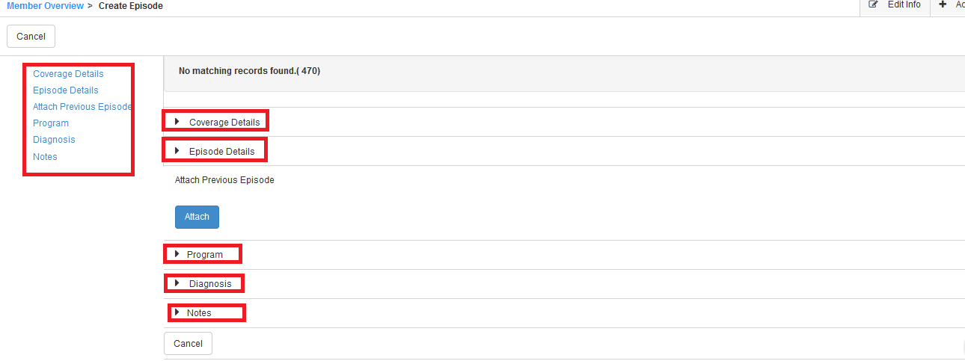
AddEpisodeLeftNavLinksConf
This XML file enables you to configure the “left navigation links” while addding an episode.
Show/hide the left links of Create episode is configurable

Slide 20
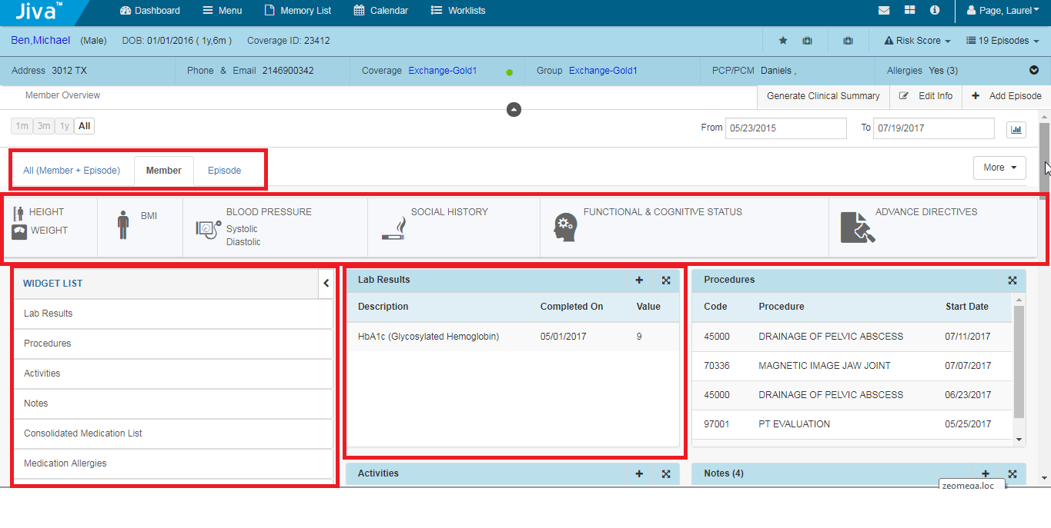
CentricViewConf
This XML file enables you to configure the widget at Member and episode level
Show/hide ALL, Member, Episode tabs and we can change order by placing entries in order in XML
Can show/hide Utility banner, Widget list

Slide 21
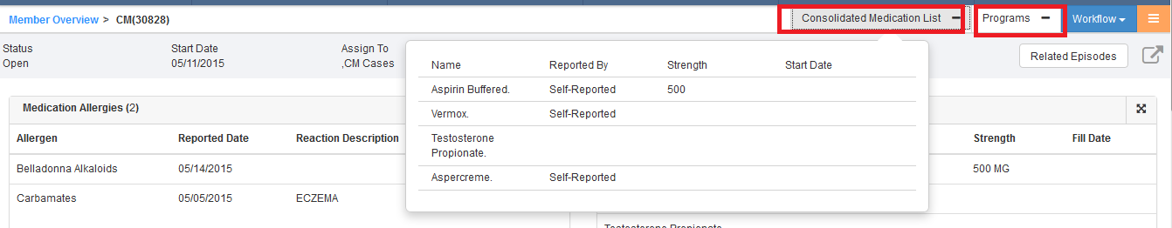
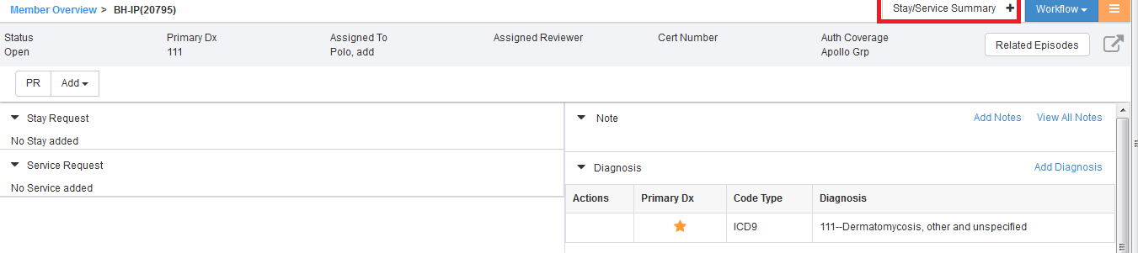
EpisodeBannerActionsConf
This XML file enables you to configure the episode actions
Configure for which episode these episode banner action links are required

Slide 22
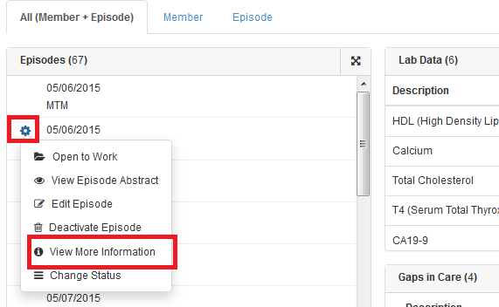
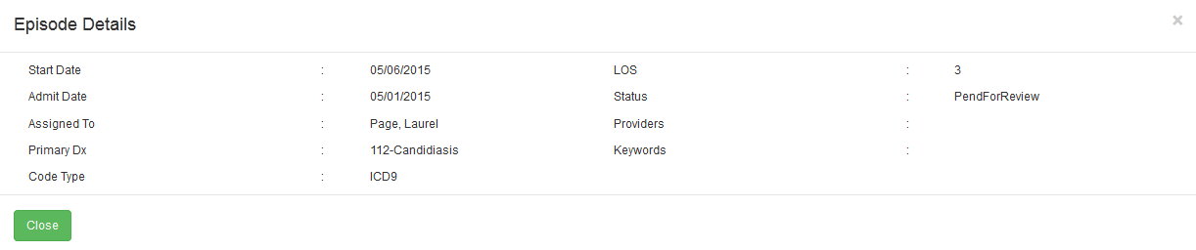
JivaEpisodeHubbleConf
This XML file enables you view the episode related more information
Show/hide the fields in more information and title can be changed

Slide 23
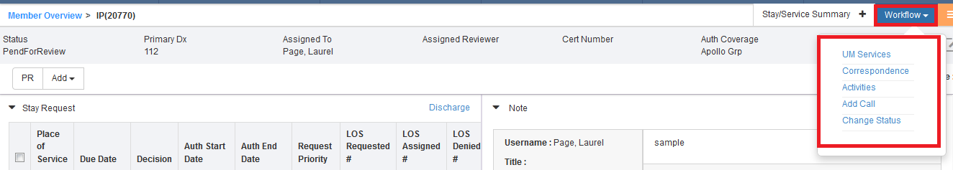
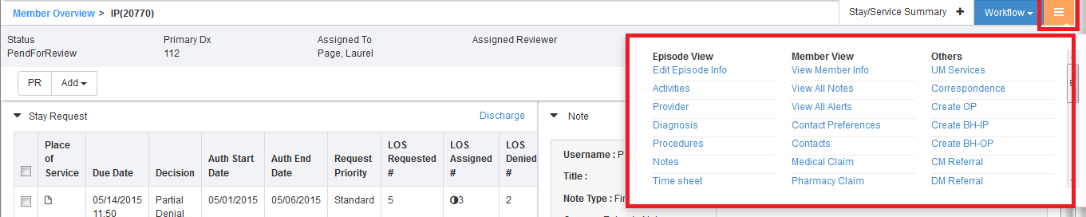
JivaQuickNavConf
This XML file enables you to configure the workflow(quick links) and sublinks and roles assigned to each link

Slide 24
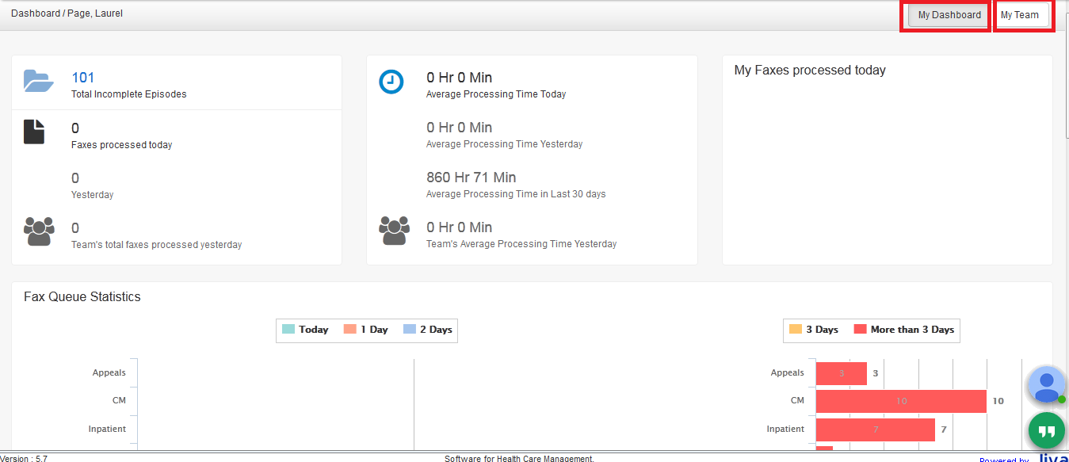
NgDashboardConf
This XML file enables you to configure the dashboard like show/hide the widget and roles assigned to each widget

Slide 25
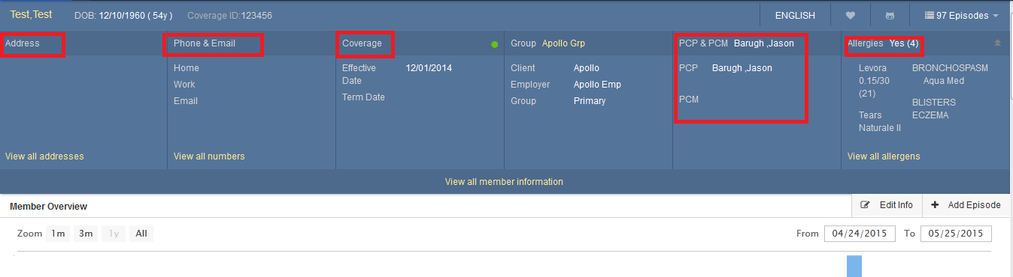
MemberDemographicsConf
This XML file enables you to show/hide the member demographics related fields

Slide 26
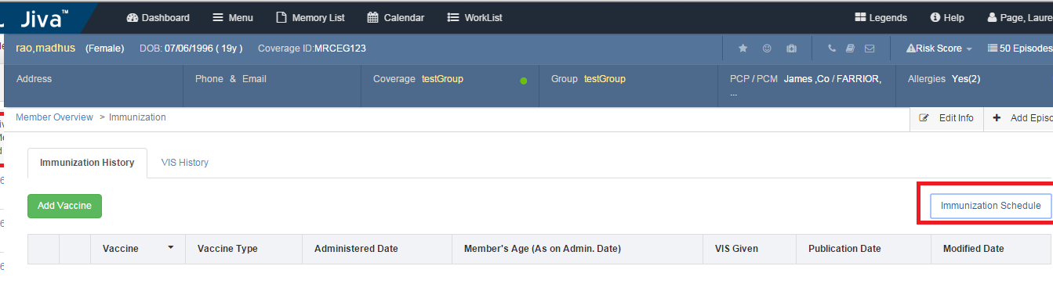
JivaImmunizationSchedules
This XML file used to configure the immunization schedule links based on age of the Member at MCV.

Slide 27
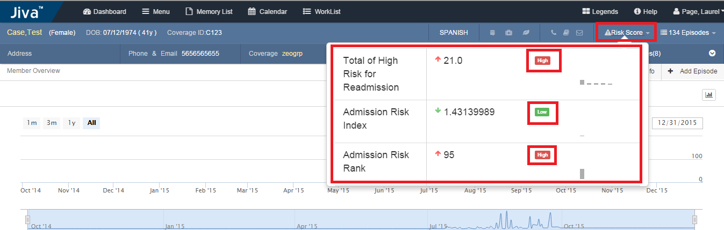
memberRiskScore
This XML file categorizes the member risk score based on the range to be displayed in UI like high, low, medium.

Slide 28
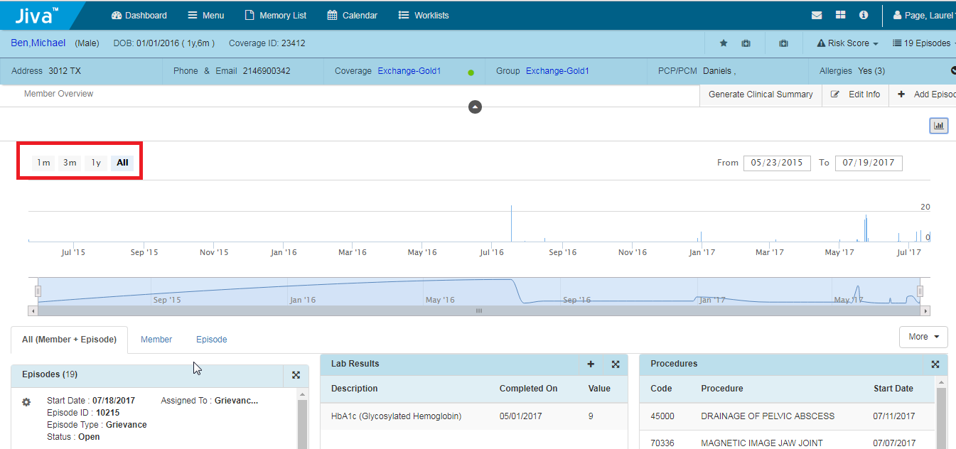
centricviewtimelineconfig
This XML file enables the data to be displayed in widgets based on the time line configured in the XML.

Slide 29
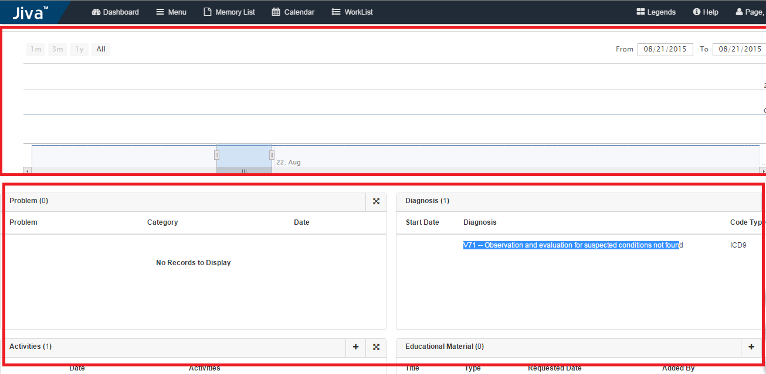
EpisodeTimeLineCountDetails
This XML file enables the data to be displayed in widgets (Both Member and Episode widgets) which are considered in the XML based on the time line selected at the episode level.

Slide 30
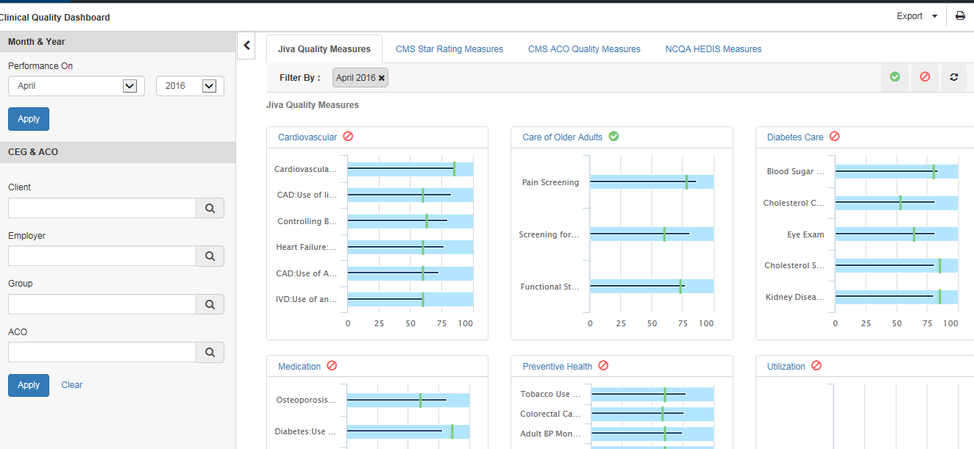
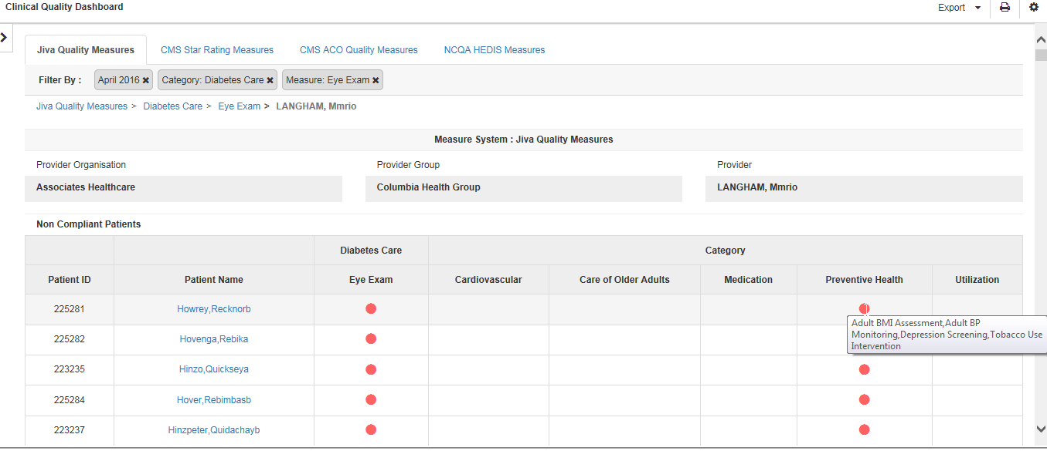
ClinicalPerformanceManagement
XML file is used to configure CPM’s 1st & 4th level label names,legends,chart size,color

Slide 31
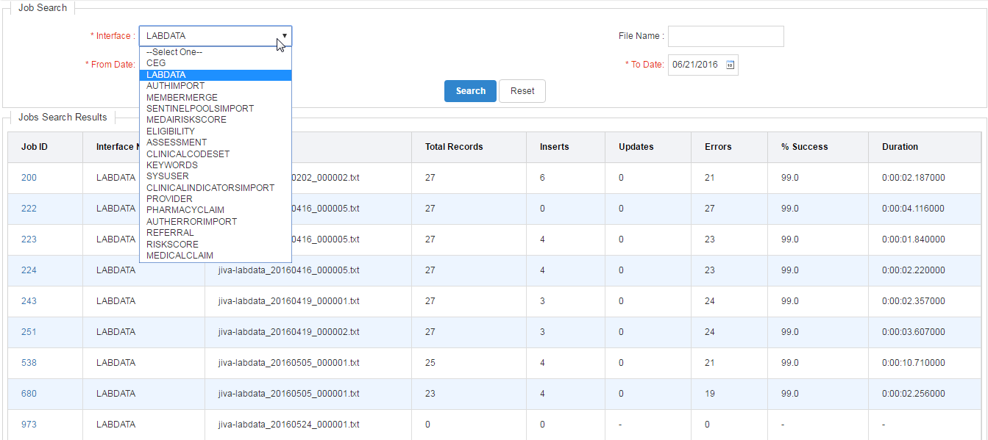
Interface XMLs
Used to configure interface “Success” and “Error” Log Tables.
Used to configure spec names (layouts) for particular interface deployed for the client.
Used to configure Interface error types.

Slide 32
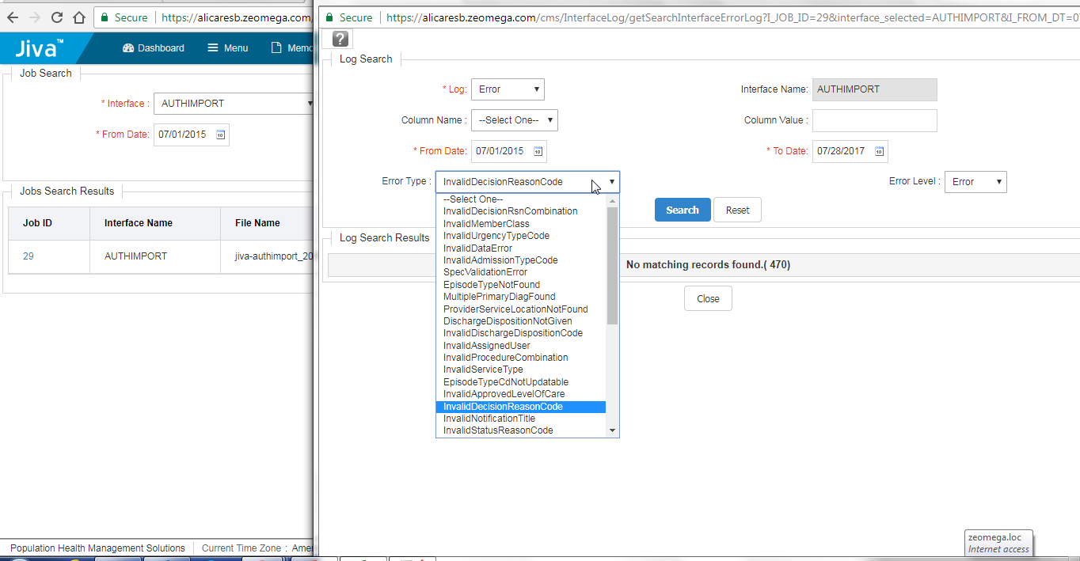
Interface XMLs

Slide 33
UMServiceConfig
Configurations pertaining to the UM services screen i.e) review, discharge and extend icons can be achieved.
Based on entities such as
Discharge link to display based on Role
Decision & Episode Status etc.
Configuration of Review, extension, Add and edit
Columns configurable in UM services listing screen for Stay, stay extension , stay review and services, service review , service extend
Column in decision screen for stay & service grid and edit service request screen

Slide 34
AppealEpisodeConfig
Configurations pertaining to the Appeal episode screen
Based on entities such as
Decisions to display
Decision Reasons
Roles
Grid table configurations for appeal stay or service

Slide 35
Environment_Options
Used to configure various entities across Jiva based on different environments (i.e Local, Mass, Dev, UAT and Prod)
Entities list includes :-
Code table config support (add/modify)
Notification
Fax (inbound/outbound/archive)
CWQI
CERME
SSRS Reports URL
Portal Auth Source
PDF service
Medispan
Health wise
EMMI
Medai etc.

Slide 36
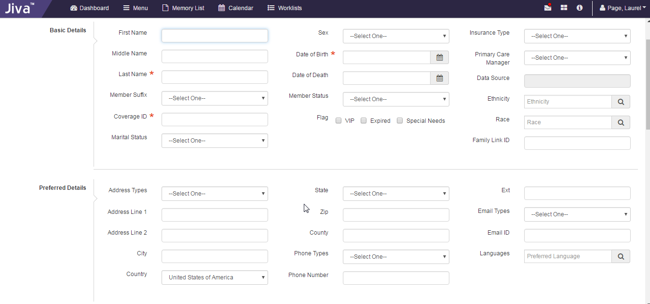
JivaLabels
This XML file enables you to configure the various labels (field names) across the Jiva application. For example: Member, Client, Member ID etc.

Slide 37
JivaNgCustomFields
This XML file enables you to configure the following:
Mandatory fields.
Hide/show any field.
Format of the field ie., text value, drop-down list or check boxes
Field Length
Autocomplete Check etc.

Slide 38
Jiva Configurable
This XML file enables you to configure the other links and fields across different screens in Jiva that are defined in Jiva Configurable.

Slide 39
Elements can be modified in XML
Show
Mandatory
Header
Title
Label
name
Roles
Type (Episode type)
For few of the XML we may have order to set.
For few XMLs , Order will display based on the XML tag line (order) followed in the XML

Slide 40
Steps to follow post XML Configuration
Once the XMLs are Configured in any Instance we need to do the following steps.
Please do the restore XML Configuration which is available under Config > Configuration > Manage XML Configuration
Please Clear Cache which is available under Config > Configuration > Manage XML Configuration

Slide 41
XML movement process in PMG
Sprint DEV
DEV add the defined config to DEV instance
Validate the XML during sprint testing
PO team configure XMLs into Int
Exit
Config team pushes the XMLs from Int to other instances

Slide 42
Q and A

